Slide 1
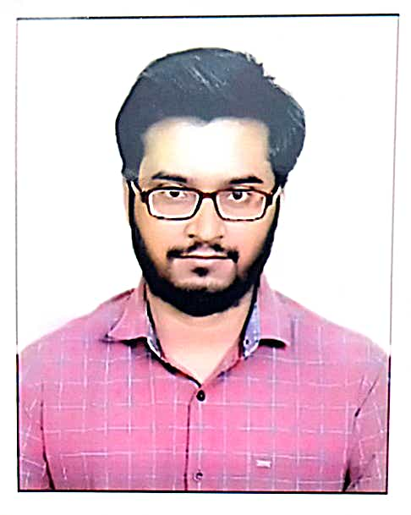
Abhinav Akash
Bachelor of Technology,
Mechanical Engineering : 2018-22
Analyst/Software Engineer
Skills
Java8,J2EE | Java Basics, OOPS, Generics , Collections ,Arrays, Loops, Streams, API, Junit, Mockito.
Spring Core | IOC & Dependency Injection , Autowire.
Spring Rest | REST controllers, implementation of CRUD Operation , Exception Handling, Testing services.
Spring Data JPA | Implementing Dao Layer using Spring Data Repositories, Transaction Management.
Spring Boot Microservice | Spring Boot Starters, annotations, Messaging Services, Swagger API,
Database | Oracle , MongoDB
Angular | Components , Services, Modules ,Routing, Forms & Variables
UI Tech | HTML 5 & CSS 3, Javascript, Typescript,Angular Material, Optimised UI Designed using Angular
Tools | Git, Postman, Maven, IDE
MUMBAI
Abhinav.akash@capgemini.com
+91 7667321137
A4
Full Stack Developer
An optimistic learner with knowledge in both Front-End and Back-End Development with good communication skill who is always eager to contribute to the advancement of knowledge.
Good knowledge of java programming and proficiency in spring framework and spring boot and creating Single page web application in Angular with working knowledge on template-driven reactive forms , routing and Angular material.
Experience in creating documentation with Java Docs and Swagger and in unit testing using Junit ,Mockito including code quality compliance and development experience using Eclipe IDE, VS code, Postman API connection and MongoDB
AGRICULTURE CROP SYSTEM
Completed case study of agriculture crop system implementing microservice architecture along with API Gateway , Backend with java , Spring boot and MongoDB, Swagger, responsive UI with Angular
BOOK STORE APP
Completed Bookstore App project for Capgemini Internship which was in Monolithic Architecture with Java, Spring Boot , H2 Database and responsive UI with angular.

